Slide 1
Energy-Water-Food Nexus: Select Observations
By
Mukul Asher
National Level Interaction Meet organized by NCCSD, October 7 2022, Ahmedabad, Gujarat

Slide 2
Introduction
My remarks on the national interaction on Energy-Water-Food Nexus are inspired by shri Ashwinbhai Shroff. I am grateful to him for posing important intellectual challenges in this area.
I will first present select thoughts which revolve around the notion that lifestyle and economic and social restructuring are needed involving everyone to manage this nexus in a sustainable way.
India’s progress in sustainability is also briefly stated in the Intriduction.
I will then suggest that alarmist views, often based on not following scientific method can not be a basis for good policy. This is not to minimize the energy-water-food nexus.
This is followed by illustrative examples of life style choices which could help manage energy-Water-Food Nexus.
Finally, the concept of circular economy as a framework (which aids thinking, it is not a blueprint) to address the challenges of the Nexus is explained.

Slide 3
Select Thoughts
“The greatest danger to our planet is the belief that someone else will save it.“
Speaking at the World Sustainable Development Summit - High Level Round Table on Rebooting Green Growth organized by the Energy and Resources Institute (TERI), Jaishankar argued that there was a need for evolving a comprehensive approach which covers education to values and from lifestyle to developmental philosophy.
“We need global awareness to bring about behavioral change,” he argued, stating that respect for nature, judicious use of resources, reducing its needs and living within its means have all been important aspects of India’s traditions
https://www.indianewsnetwork.com/20210211/india-is-a-leader-in-climate-action-eam-jaishankar
Accessed on 3 October 2022

Slide 4
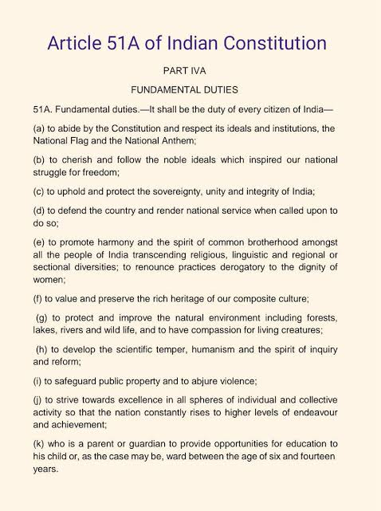
We know our Fundamental Rights. We should also know our Fundamental Duties.

Slide 5
Select Thoughts
PM Modi referring to the use of science in the modern-day said, 'Science is Universal and Technology is Local.’
The PM further emphasized how to make use of science and technology so that it helps us to elevate our
'ease of living.' He talked about increasing investments in house constructions, railways, airways,
waterways and optical fibers and called out to the youth to give ideas for technological advancement in these areas

Slide 6
Introduction
https://www.livemint.com/opinion/online-views/sustainable-development-goals-how-india-and-the-world-are-doing-11664731506364.html
Accessed 2 October 2022
Bjorn Lomborg,Bibek Debroy,Aditya Sinha
As compared to other parts of the world, India seems to be an outlier and performs better than World Bank income groupings would suggest. While India starts out somewhat below its own lower-middle income group, it almost catches up, especially over the last four-year period before the covid pandemic, 2015-19, where India spurts with a 4-percentage point growth, compared to 3.1 for lower-middle income countries in general.
On current 2015-19 trends, India is likely to overtake its lower-middle income country group before 2030. On current trends, the country is set to complete its SDGs around 2059. While this is still almost three times slower than the promise of 2030 for SDGs, it is much better than the performance of any grouping of countries by income category, or indeed the world.
The world and India ought to focus on the most effective targets first. Cost-benefit analysis can help us identify these very best promises to fulfil first.

Slide 7
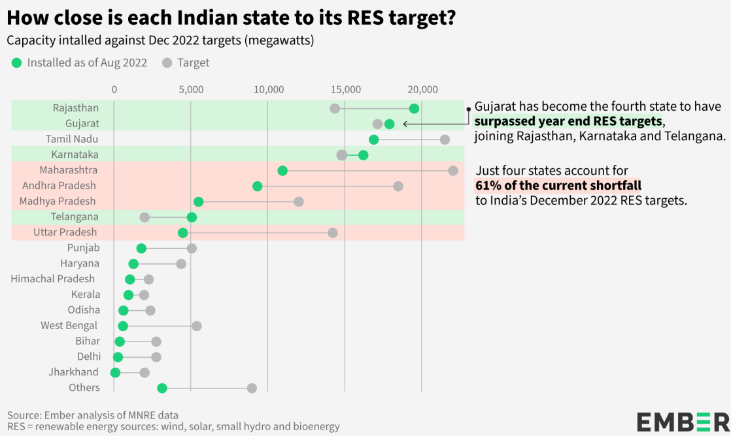
Introduction

Slide 8
A Contrary View on Climate Change by
Michael Shellenberger
Many believe climate change will make humans extinct, but there isn't a single apocalyptic scenario in the reports by the UN Intergovernmental Panel on Climate Change. Now, the data make clear that weather-related disasters are actually going down.
Detailed analysis in
https://environmentalprogress.org/the-case-against-environmental-alarmism
Accessed on 10 September 2022

Slide 9
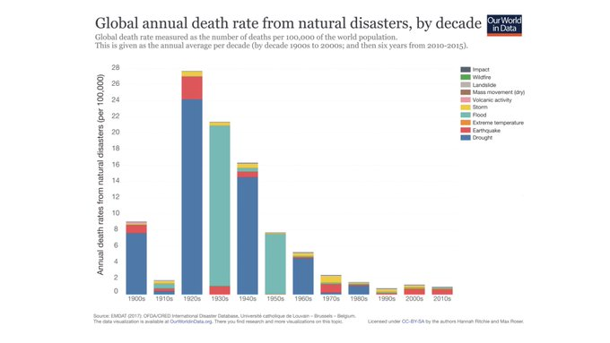
A Contrary View on Climate Change by
Michael Shellenberger

Slide 10
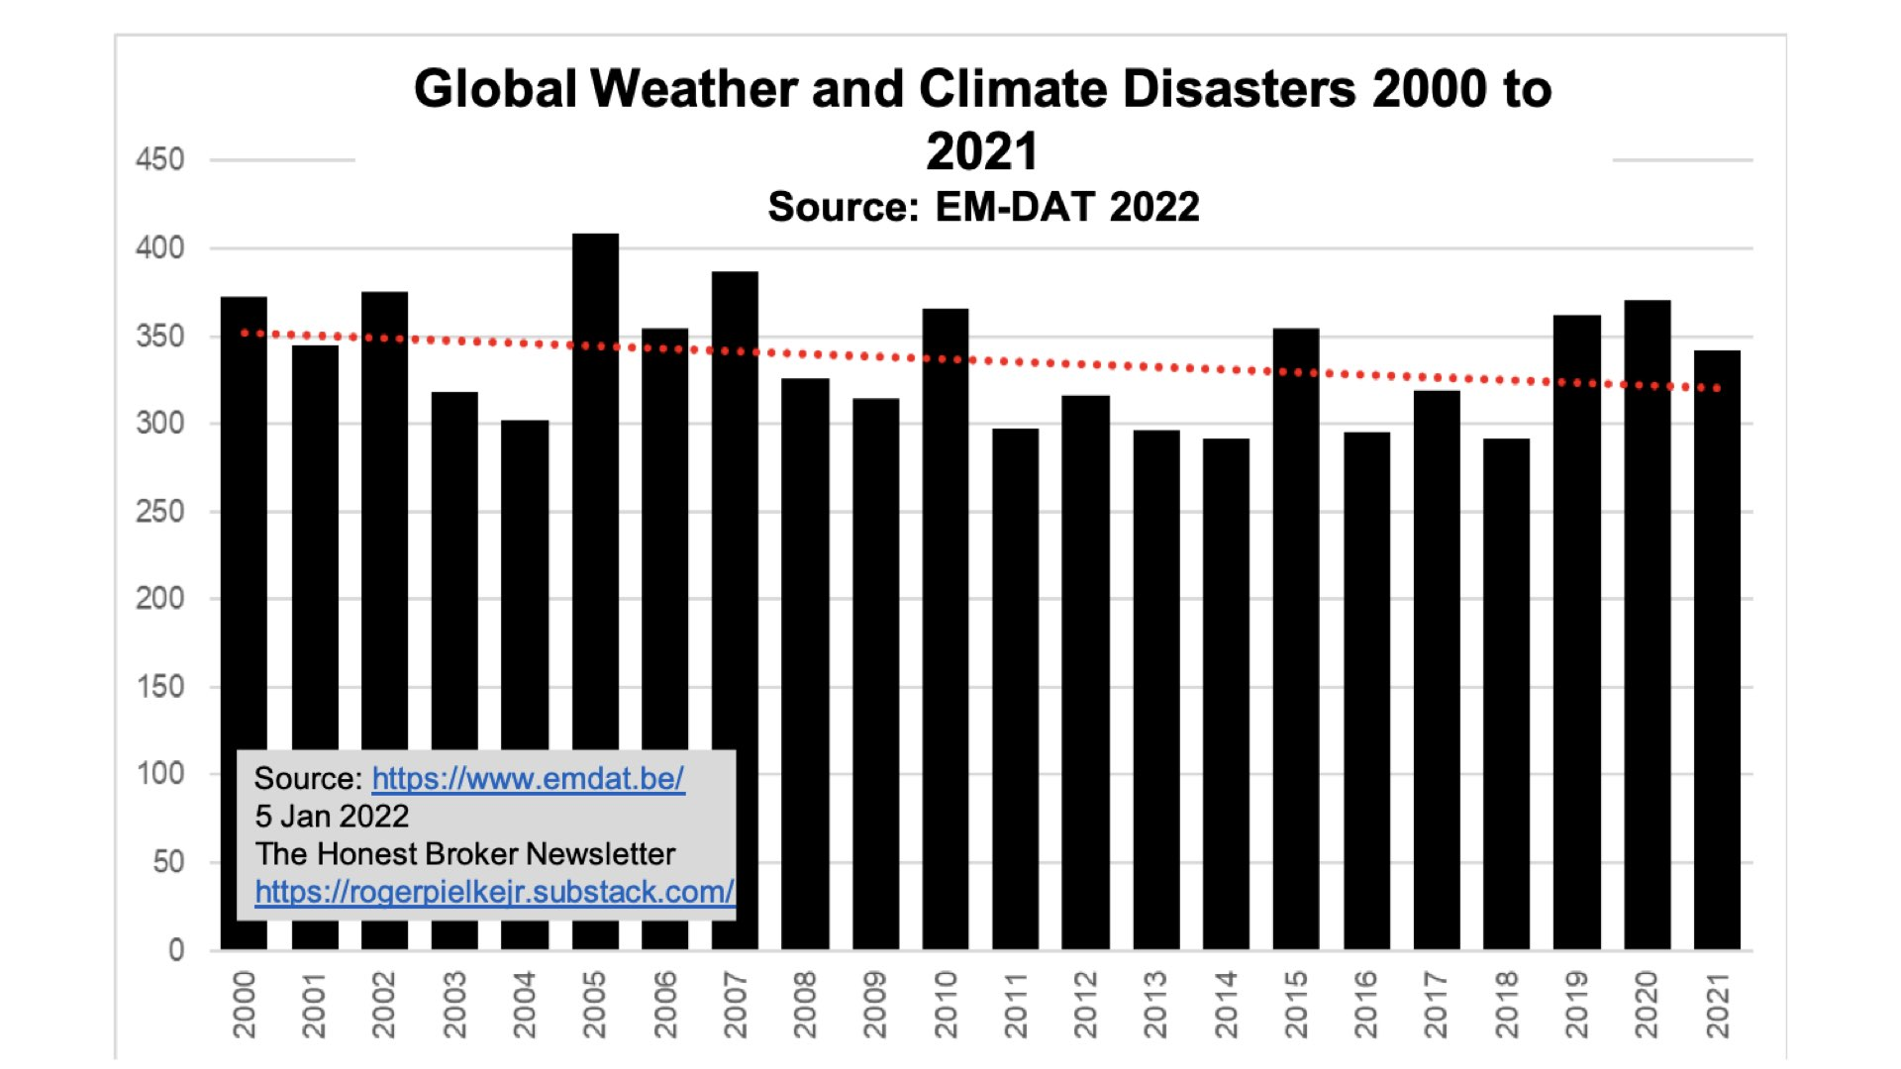

Slide 11
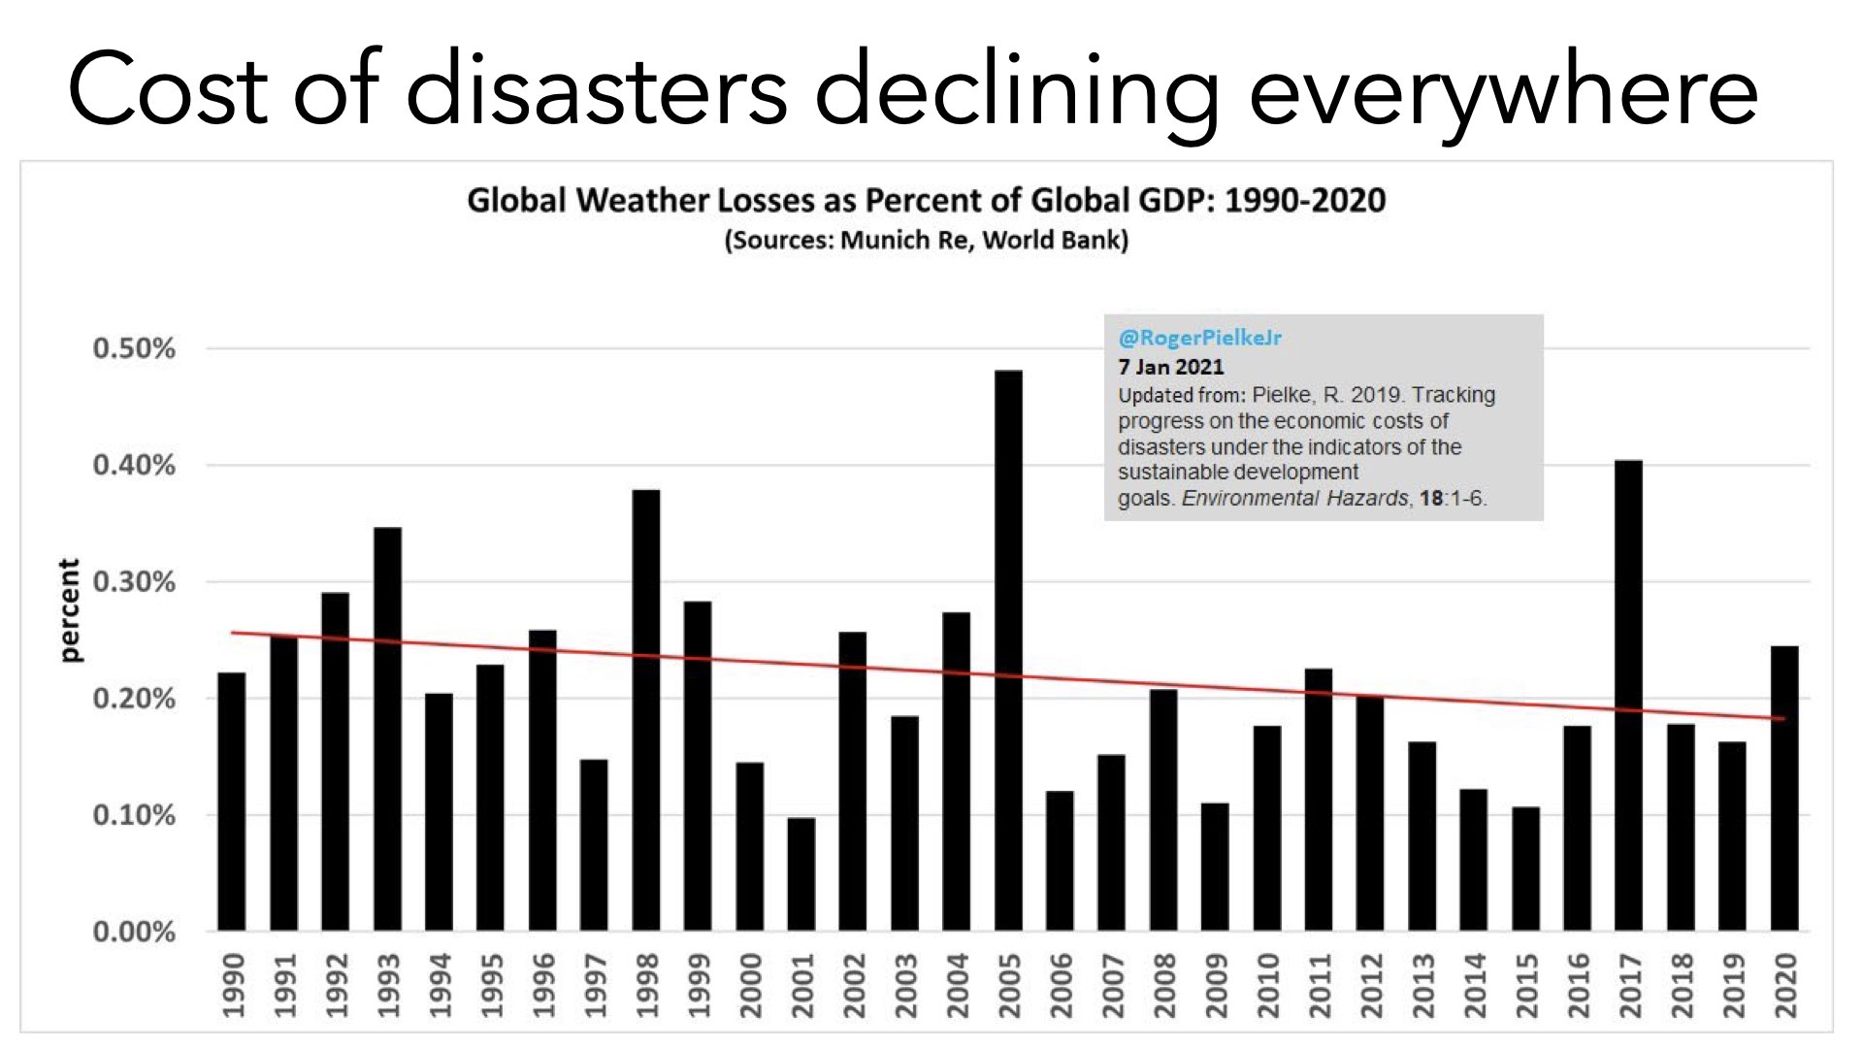
A Contrary View on Climate Change by
Michael Shellenberger

Slide 12
A Contrary View on Climate Change by
Michael Shellenberger
What about renewables? We are not going to transition to them for inherently physical reasons. They only exist through massive government subsidies, on both supply (China) and demand (US & Europe) ends. That will come to an end as materials prices rise.
Many think we will subsidize our way to renewables, but we won't, for inherently physical reasons. Sunlight & wind are too energy-dilute. Solar/wind projects need ~300x more land, 300% more copper, and 700% more rare earths than fossil fuels, making them prohibitively expensive.
California saw its zero-carbon electricity *decline* despite having spent more than anyone else on renewables, while Germany's renewables peaked in 2020 and declined last year. California has the second most expensive electricity in US. Germany the most expensive in Europe

Slide 13
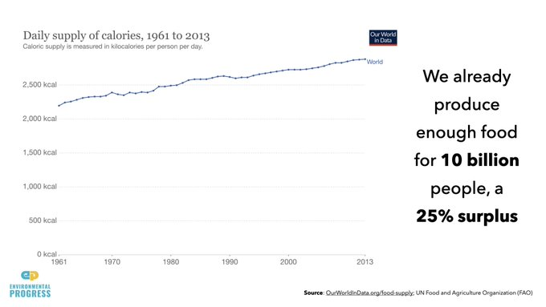
A Contrary View on Climate Change by
Michael Shellenberger

Slide 14
What about food production? We already produce enough food for 10B, a 25% surplus, and more than ever. Yields are still rising. And gaining access to irrigation, fertilizer, and modern technology will massively outweigh any impact of warmer temperatures, according to the UN FAO.

Slide 15
A Contrary View on Climate Change by
Michael Shellenberger
I had many dark & lonely moments advocating for nuclear power over the last decade. I was falsely accused of many things. Through it all, I kept the faith. I knew people would one day see the light. It took a global energy crisis, but finally they do.
So what do we do now? Add more reactors to the nuclear plants (eg Diablo) we have. Nuclear wants to be big & boring. We need designs that people have experience building and operating, not complicated, expensive, futuristic design nobody knows how to build, operate, or regulate.

Slide 16
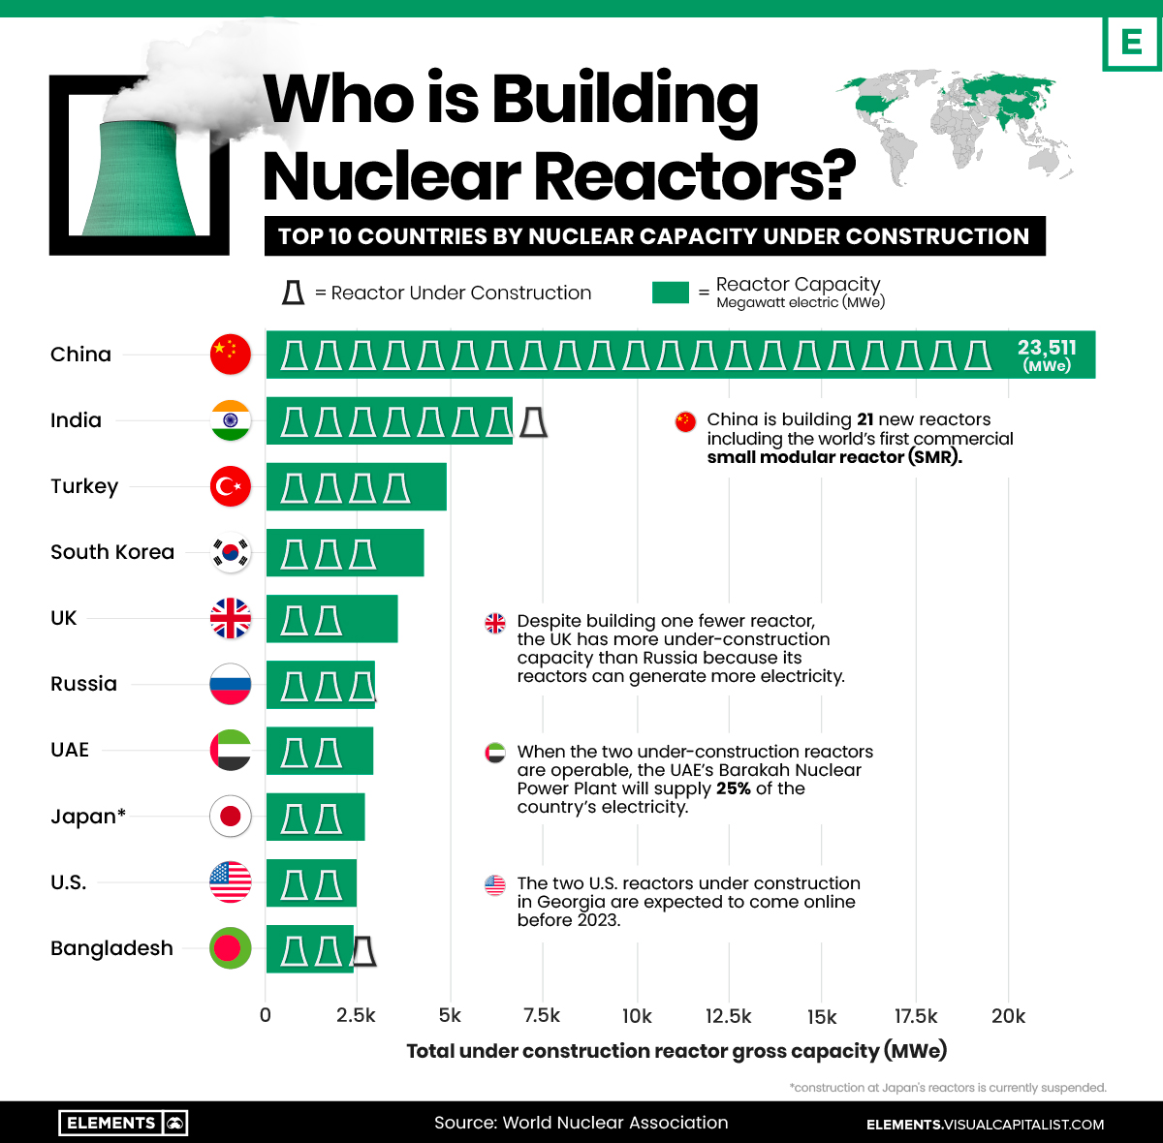

Slide 17
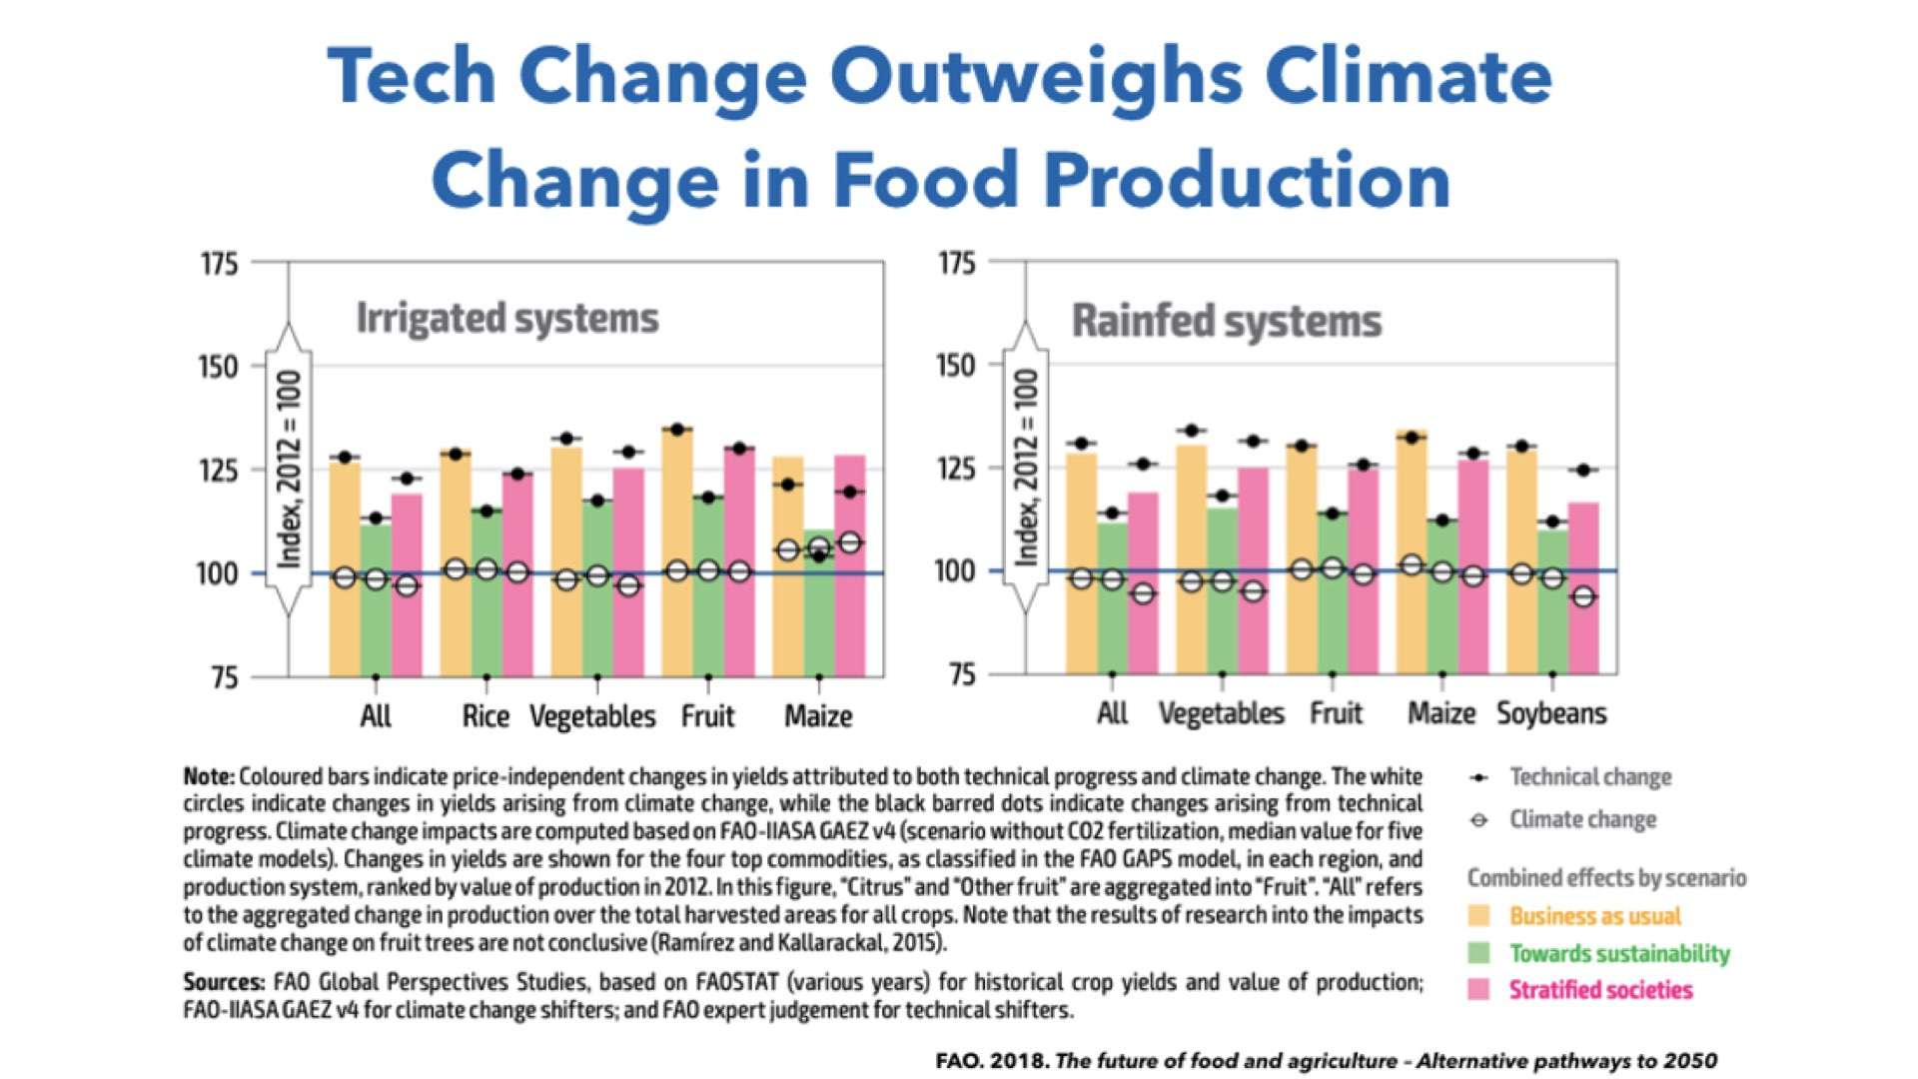
A Contrary View on Climate Change by
Michael Shellenberger

Slide 18
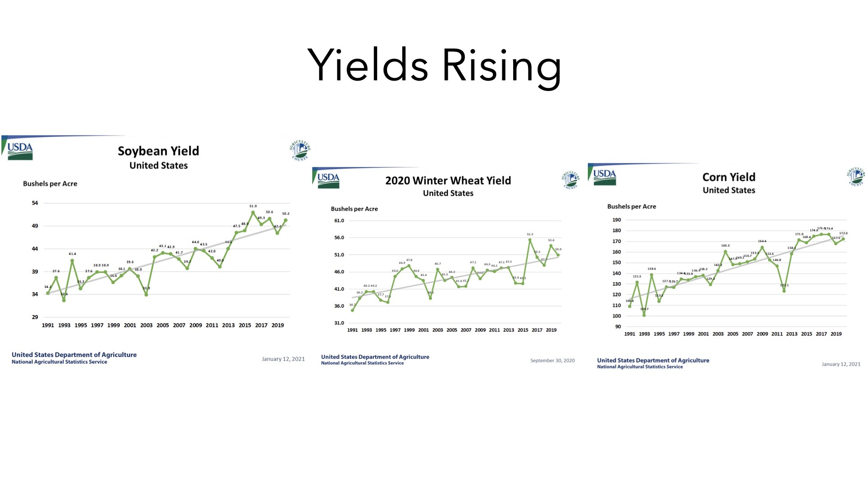
A Contrary View on Climate Change by
Michael Shellenberger

Slide 19
https://www.mckinsey.com/industries/consumer-packaged-goods/our-insights/reducing-food-loss-what-grocery-retailers-and-manufacturers-can-do?stcr=D7CA47E8203F4E0E81FB35FE755B7869&cid=other-eml-alt-mip-mck&hlkid=7a412f46ce0544f9a2a9d718a84ab956&hctky=1174219&hdpid=193199b7-dedd-413c-9642-74bf69cf11a8
ACCESSED ON 7 September 2022
Roughly $600 billion worth of food is lost each year before it ever reaches store shelves or consumers.
This week, a McKinsey article looks at ways for farmers, manufacturers, and grocers to reduce food loss.
Conserving food could ameliorate global hunger, diminish carbon emissions, and be good for business.
Meanwhile, a look at Fortune Global 500 companies’ stances on environmental harm finds that most set climate-related targets but far fewer establish targets connected to issues such as freshwater consumption or biodiversity loss.
The world squanders 33 to 40 percent of its annual food production, incurring needless greenhouse-gas emissions along the way.
About half of this results from “food loss,” which occurs during production and processing stages and is not to be confused with “food waste,” which happens after food is distributed to retailers and consumers (exhibit).
There are three food loss culprits:
farms producing more food than they can sell,
stringent customer requirements that make some edible food unmarketable,
and handling damage that renders food unfit to eat

Slide 20
Implications from the Contrary view
Analysis by Asher
Do not be complacent or alarmist about climate change. Gaps in our knowledge is high.
Downside risk, even if probability is low, can create tremendous hardships. (Black-Swan events)
Continue to pursue sensible steps based on scientific method and reasoning (see what this contains in the next slide). These should include making fossil fuels, including coal production-consumption chain more efficient; building nuclear power plans; encouraging decentralized small scale context-specific energy conserving initiatives, and life style changes.
Note: How much of so called environmental activism is based on scientific method and reason instead of science worshipper’s method in the next slide

Slide 21
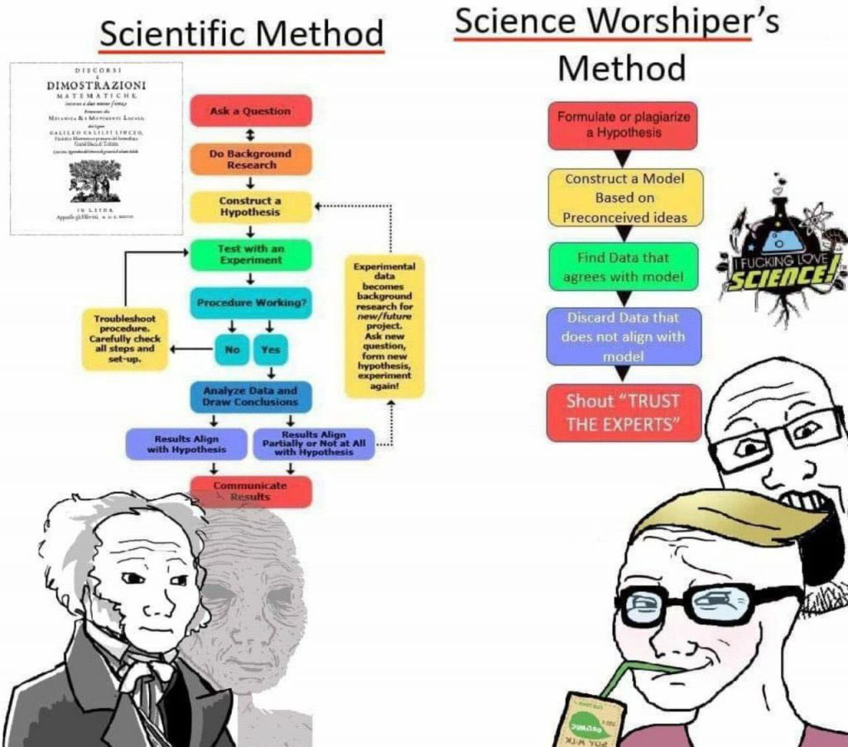

Slide 22
Minhaz Merchant
India will have to balance its laudable 2070 net-zero target with a gradual but pragmatic shift away from fossil fuels without sacrificing an iota of its economic growth potential.
https://www.firstpost.com/opinion-news-expert-views-news-analysis-firstpost-viewpoint/head-on-after-polluting-the-world-for-300-years-the-west-lectures-india-on-climate-change-11199451.html
Accessed on 7 September 2022

Slide 23
Russia’s largest coal company in talks to set up India office
CEO Maxim Basov told ET in an exclusive interview that the company’s shipments to India, traditionally a smaller importer of Russian coal, increased to 1.25 million tonnes in the first six months of 2022, twice more than in the entire 2021.
https://economictimes.indiatimes.com/industry/indl-goods/svs/metals-mining/russias-largest-coal-company-in-talks-to-set-up-india-office/articleshow/94125409.cms?utm_source=newsletter&utm_medium=email&utm_campaign=NewsDigest&utm_content=Industry&utm_term=2%20%20%20%20%20&ncode=468594c62df3f07d83dfd3e1223657add1ac6977d6df13b152555335f1503e0ecddf1ce6d89e5f78264a19baf8f4dc92387813e1af55184b83559ca15536f380ff6952297a881f7488277ccfec8a848a
Accessed on 11 September 2022

Slide 24
Lifestyle Choices
http://mck.co/3AASTFB
14 key technologies shaping the next decade:
1 applied AI
2 5G/6G
3 bioengineering
4 clean energy
5 sustainable consumption
6 web3 (metaverse)
7 industrial machine learning
8 immersive reality
9 cloud computing 10 digital identity

Slide 25
Lifestyle Choices https://www.wionews.com/videos/meat-ads-to-be-banned-from-public-spaces-netherlands-to-go-meat-free-513699 accessed on 7 September 20022
A Dutch city has decided to ban all meat advertisements from public spaces in an effort to reduce the consumption and green gas emissions. Haarlem in the Netherlands will enforce the ban from 2024 and with this it will become the first city in the world to ban meat ads.

Slide 26
Lifestyle choices
A 47-member panel to draft National Cooperation Policy document was set up in India in early September 2022
In India, a new document is being formulated with a view to fulfilling the mandate given to the new ministry of cooperation, which includes realising the vision of 'Sahakar se Samriddhi'; strengthening cooperative movement in the country and deepening its reach up to the grassroots; and promoting cooperative-based economic development model.
"The new policy will go a long way in strengthening the co-operative movement in the country," the statement said.
The committee should submit the final draft within three months from the date of its first meeting.
It is strongly urged that this panel incorporate:
How to shorten inputs-production-consumption-recycling chain in some areas
How to promote environmentally more compatible lifestyles

Slide 27
Lifestyle Choices
The makers of SUVs (and they are now hugely popular in India, especially real SUVs that can pretty much go anywhere) are either unaware or do not care about the irresponsible way in which their vehicles are driven in the ecologically fragile grasslands outside Bengaluru or the equally (if not more) ecologically fragile Aravallis outside Delhi and Gurugram.

Slide 28
Lifestyle Choices
At least two food delivery companies (including the largest) now offer inter-city deliveries, adding to the carbon footprint of food – perhaps the third most irresponsible activity that a food company can engage in, at least in my opinion (selling sugar and fat using the sheer power of marketing has to be the first; the use of unsustainable palm oil is the second).

Slide 29
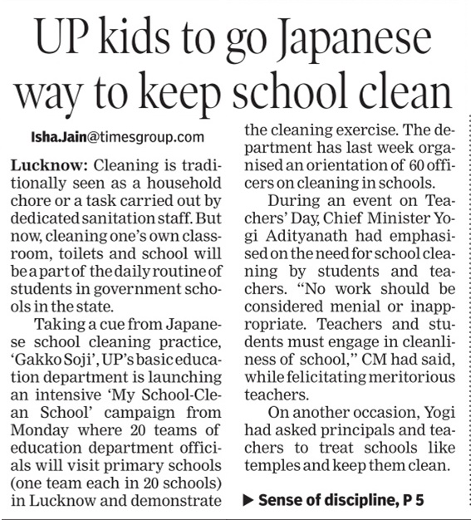
UK supermarkets have removed “best before” dates on thousands of fresh food products in an effort to reduce food waste ‘Best before’ is generally a guideline for quality, taste, freshness... totally different to ‘use by’ dates which are about food safety

Slide 30
Lifestyle Choices
The government is strongly encouraging solar and wind energy-based charging mechanisms for electric mobility.
It is also working on developing electric highways, which will be powered by solar energy and this will facilitate charging of heavy duty trucks and buses while running.
An electric highway generally refers to a road which supplies power to vehicles travelling on it, including through overhead powerlines.
toll plazas are to be powered by solar energy.
https://government.economictimes.indiatimes.com/news/technology/govt-working-on-developing-electric-highways-powered-by-solar-energy-union-minister-nitin-gadkari/94170128?utm_source=Mailer&utm_medium=newsletter&utm_campaign=etgovernment_news_2022-09-14&dt=2022-09-14&em=bXVrdWwuYXNoZXJAZ21haWwuY29t
Accessed on 13 September 2022

Slide 31
Lifestyle Choices
Union Minister Nitin Gadkari has argued for the need to reduce logistics costs in the country, which is higher than that of China, the US and European countries.
The idea is to make waterways as a popular mode of transport for passengers and goods as this will help in bringing down the import cost of petrol and diesel, which is around Rs 16 lakh crore for the country annually, he said.
"Our first priority is waterways, second railways, third road and lastly aviation. Bringing down logistics costs will help in generating employment in the country," he said at a programme organised by Young Indians and the Institute of Chartered Accountants of India.

Slide 32
https://www.republicworld.com/india-news/politics/need-to-reduce-logistics-cost-to-boost-growth-gadkari-articleshow.html
Accessed on 17 September 2022
Logistics cost in India as a percentage of GDP is 16 per cent, which is very high, he said, adding that it is ten per cent in China, and nearly eight per cent in the US and Europe.
Gadkari, the minister of road transport and highways, said the Prime Minister Gati Shakti programme will help in coordination among various departments, and a common right of way will be developed.
"There is a need to connect rail and road transport with the waterways," Gadkari said.
More use of sustainable fuel, such as bio-diesel, bio-CNG, will help substitute imports of petrol and diesel, he said.
He also stressed on the need for more cultivation of sugarcane and bamboo for production of cost-effective fuels like ethanol and bio-ethanol, Gadkari said, adding that the move will curb pollution.

Slide 33
Lifestyle Choices
What it costs to transport one Metric Ton of cargo, one KM?
₹1.6 in railways.
₹2 in waterways.
₹3.6 in highways.
₹18 in airways.
And, 95% of India's merchandise trade by volume happens through its seaports. That's why PM Modi is focusing heavily on turn-around time.

Slide 34
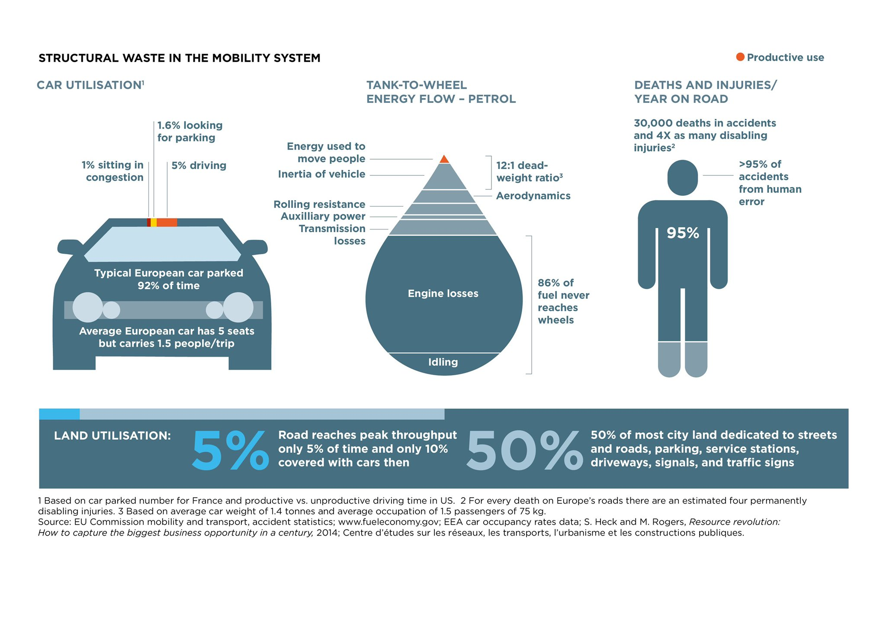

Slide 35
Lifestyle Choices
UK supermarkets have removed “best before” dates on thousands of fresh food products in an effort to reduce food waste ‘Best before’ is generally a guideline for quality, taste, freshness... totally different to ‘use by’ dates which are about food safety

Slide 36
The Circular Economy
https://theindianaffairs.com/en/what-is-circular-economy-mentioned-by-pm-narendra-modi-in-his-speech/
Accessed on 23 September 2022
Indian PM Narendra Modi asked the state environment ministers to ensure the transition to a circular economy
The annual waste generation of the country amounts to 62 million tons, and Urban India contributes more than half of it — about 42 million tons. The increase in the annual rate of ewastegeneration is an even bigger concern — with 10.14 lakh tons in 2019-20.

Slide 37
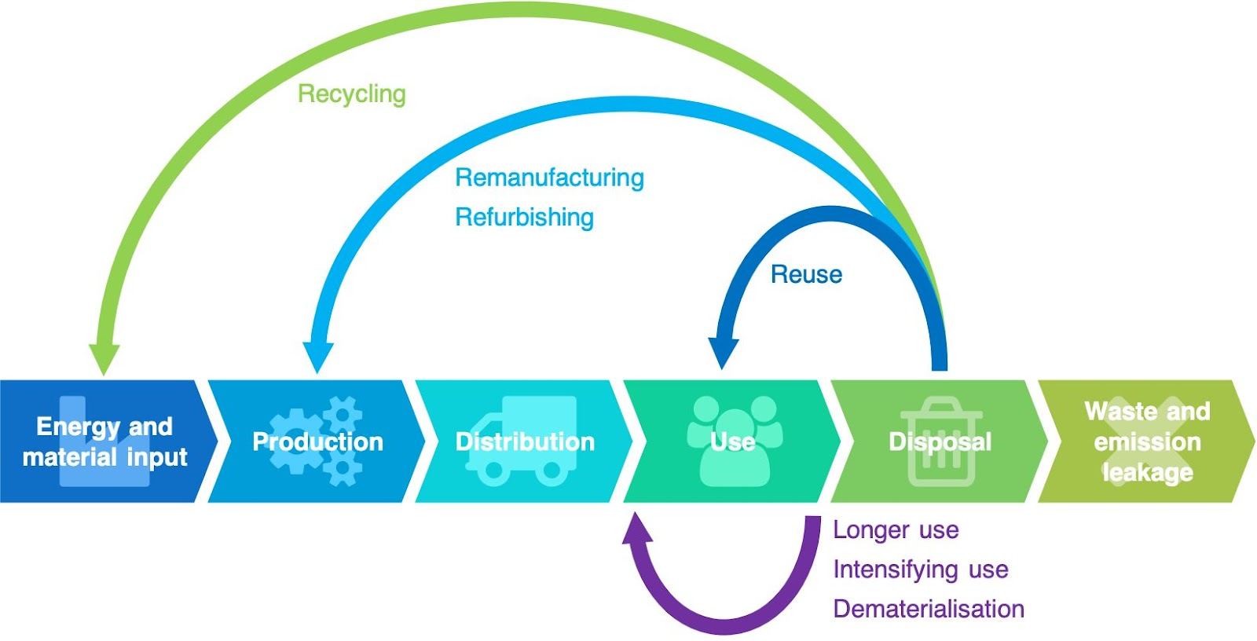
The Circular Economy https://theindianaffairs.com/en/what-is-circular-economy-mentioned-by-pm-narendra-modi-in-his-speech/
Accessed on 23 September 2022

